Slide 1

Farming and Health Solutions
Team RAS:
Astha Shah
Siddhesh Kuvalekar
Ritesh N Patil

Slide 2
Problem Statement
Farmers have lack of knowledge and awareness about emerging farming techniques which may result in loss of crop yield. Furthermore, this loss makes him ignorant towards his health too.

Slide 3


Solution
We are building the application to ease out the farmers life.
The application will have following aspects.
Provide common platform for farmer, experts, doctors and government official which helps to reduce the communication barrier.

Slide 4
Use-Cases
Three different use-cases are
System with hierarchy and authorization.
Suggestion and monitoring Procedures.
Digitizing the farmer ecosystem.

Slide 5
Farmer to Doctor interaction
Here farmer will be interacting with the doctor:
What Farmer will do? Farmer will request for advice on issues from doctor.
What will Doctor be doing?
Doctor will check farmer’s history and revert back to him.
Also the doctor will enter the vital signs data based on the regular check up of farmers.

Slide 6
Farmer to Expert interaction
Here farmer will interact with expert:
What Farmer will do? Farmer will request for advice from expert about farming.
What is Expert doing?
Expert will generate the soil report for each farmer as requested.
Expert will address the farming issues of the farmer.

Slide 7
Government to Doctor interaction
Here Government official will be interacting with the doctor:
What Government will do? Government will analyze the Health data of particular district and advice actions needed to be taken to improve situation
What will Doctor be doing?
Doctor will take actions accordingly.

Slide 8
Government to Expert interaction
Here government will be interacting with the agricultural experts:
What Government will do? Government will analyze soil graph and send the message.
What will Expert be doing?
Expert will take actions accordingly.

Slide 9
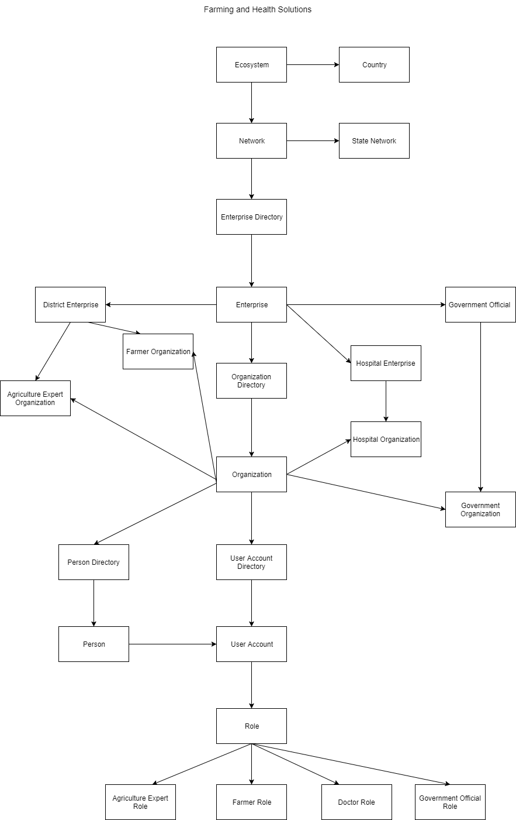
Object Model
Story for illustration purposes only

Slide 10
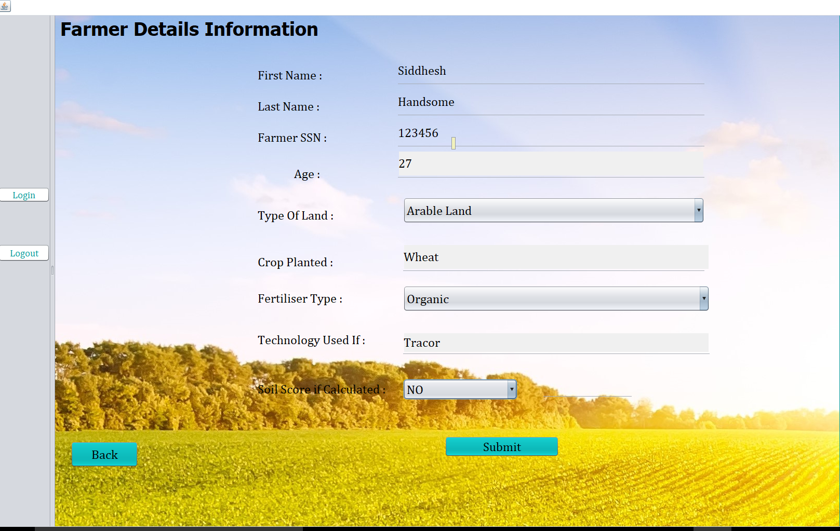
Farmer Request for the Soil Score
Story for illustration purposes only

Slide 11
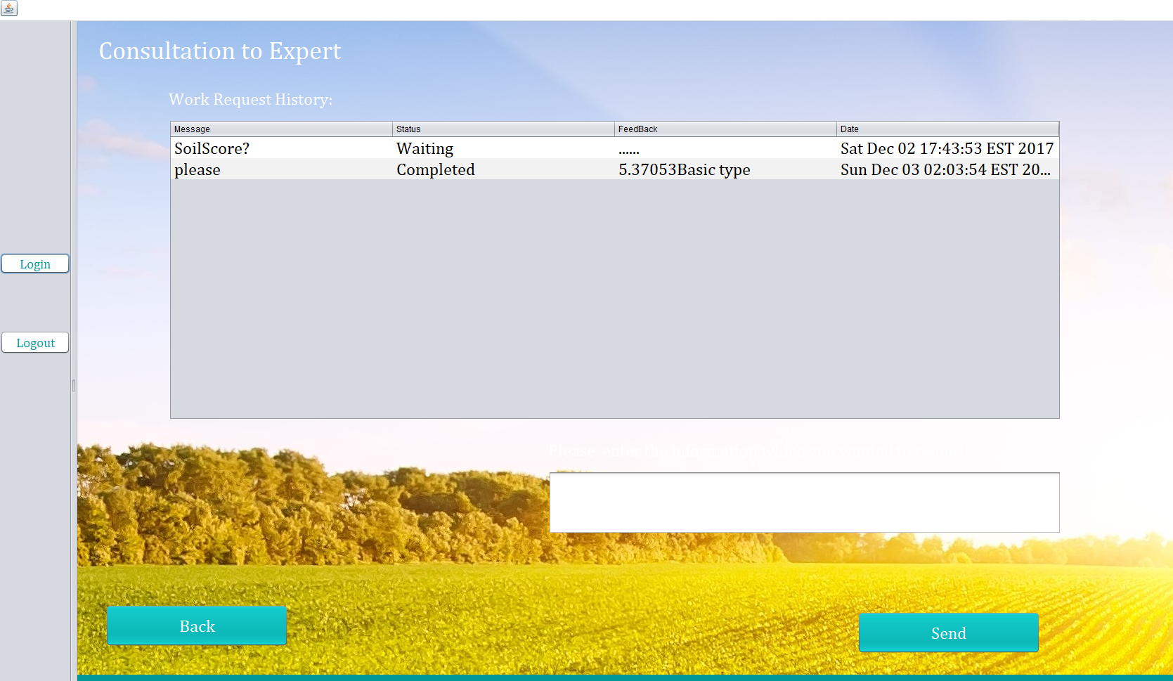
Response by the Expert
To the farmer

Slide 12
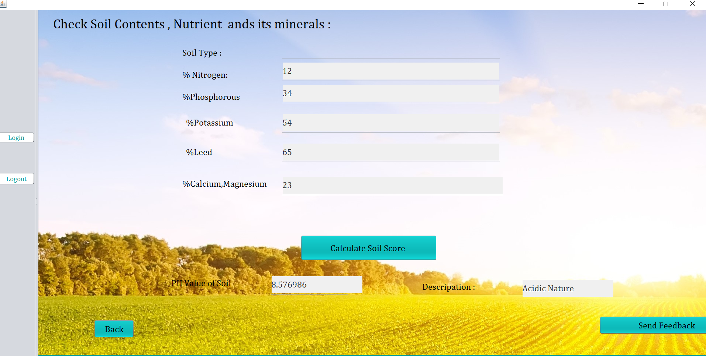
Generation of Soil Score by the Expert

Slide 13
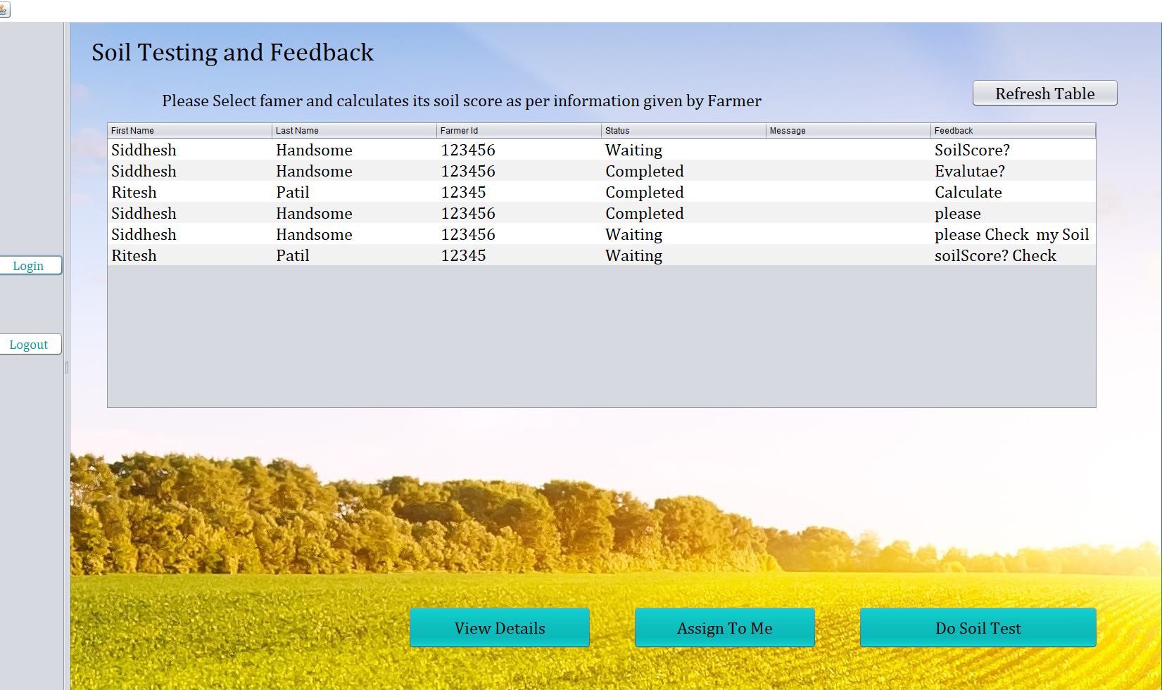
Source: theguardian.com

Slide 14
Demo

Slide 15
ThankYou!

